Slide 1
Calculation of Vegetation Indices Using Python
Prepared by:
Kameswara sharma
Mayur Sharma
Sreeja Suresh

Slide 2
Introduction
The objective of this project is to calculate different vegetation indices directly from a raster image using a GUI developed with help of Python.
The main components of the project are:
Python 2.7
PyQt
GDAL
NUMPY

Slide 3
GDAL
The Geospatial Data Abstraction Library (GDAL) is a computer software library for reading and writing raster and vector geospatial data formats.
Main functions used from gdal library are:
Gdal.open() function to open a dataset, passing the name of the dataset
Create() function to create an empty raster image taking dimensions and location as parameter
writeRaster() function to write the computed indices to the raster file takes coordinates and value as parameter

Slide 4
Start
METHODOLOGY
Select Raster Image
Open the Raster Image
LANDSAT
LISS
Check if correct file or not
Select Sensor
Create Empty Raster
-create_blank()
DVI -calc_DVI()
NDVI -calc_NDVI()
TVI -calc_TVI()
SAVI -calc_SAVI()
NDGI-calc_NDGI()
Select Vegetation Index
Write the Output

Slide 5
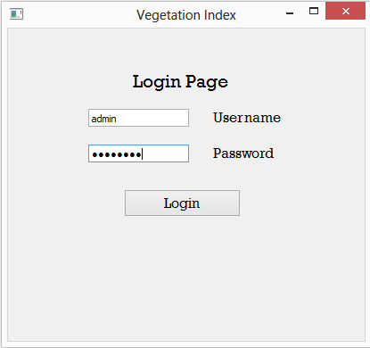
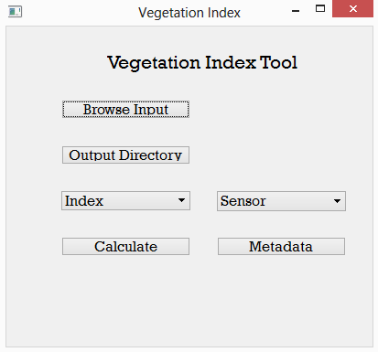
USER INTERFACE

Slide 6
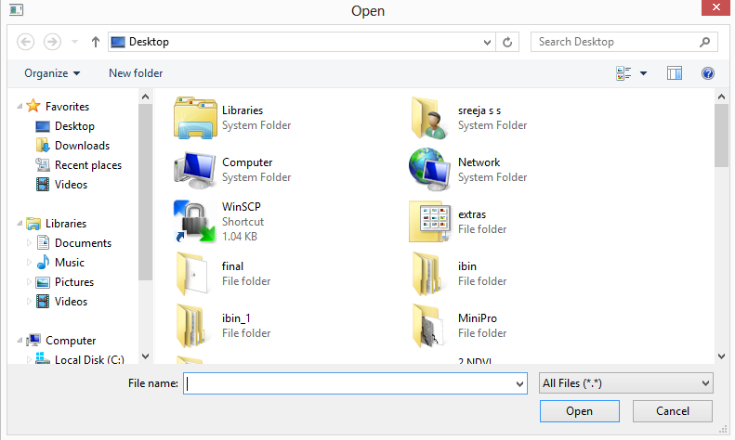
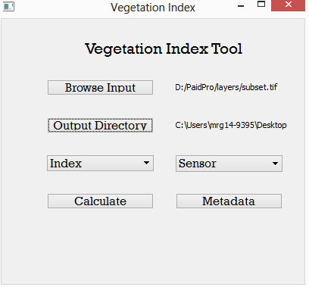
BROWSE

Slide 7
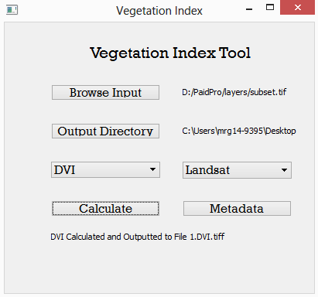
SELECTING INDEX AND SENSORS

Slide 8
TVI
RESULTS LANDSAT
NDVI
DVI
SAVI
NDGI

Slide 9
TVI
RESULTS LISS-IV
NDVI
DVI
SAVI
NDGI

